Slide 1
Modeling of Missing Data – with application to social science data
Jerry Chia-Rui Chang
Advisor: Dr. Jerome P. Reiter
Committee Members: Dr. Amy Herring, Dr. Colin Rundel

Slide 2
Introduction - Senior Executive Service (SES)
Federal Employees Data from the Office of Personnel Management (OPM)
Similar to CEO in a private company
Past studies suggest that there lacks diversity by gender, race, and ethnicity

Slide 3
Research Questions
Can we predict who get promoted based on employees’ personal and career information at working year 10?
Statistical Challenges
Dealing with Missing Data
Modeling for Promotion

Slide 4
Data
Outcome Variable
Promoted
Personal Information
Gender, Race, Education Level
Career-related Information
Start Year, Department Switch, Occupational Category, Pay Plan, Grade, Step Rate, Salary

Slide 5
Identify Potential Candidates
Career-track employees
Have at least 15 years of working experiences
Starting between 1978 to 1996
General Schedule Pay Plan with grade above 9 at working year 10
Notes:
More than 200,000 employees with around 2000 SES

Slide 6
Missing Data
Missing Completely at Random (MCAR)
Missing at Random (MAR)
Not Missing at Random (NMAR)
Notes:
MCAR: the probability of observations being missing is unrelated to other subjects in the study.
MAR: property when the probability of missing only depends on observed values but not on unobserved values.
NMAR: the probability of missing depends on both observed and unobserved values.

Slide 7
Missing Data

Slide 8
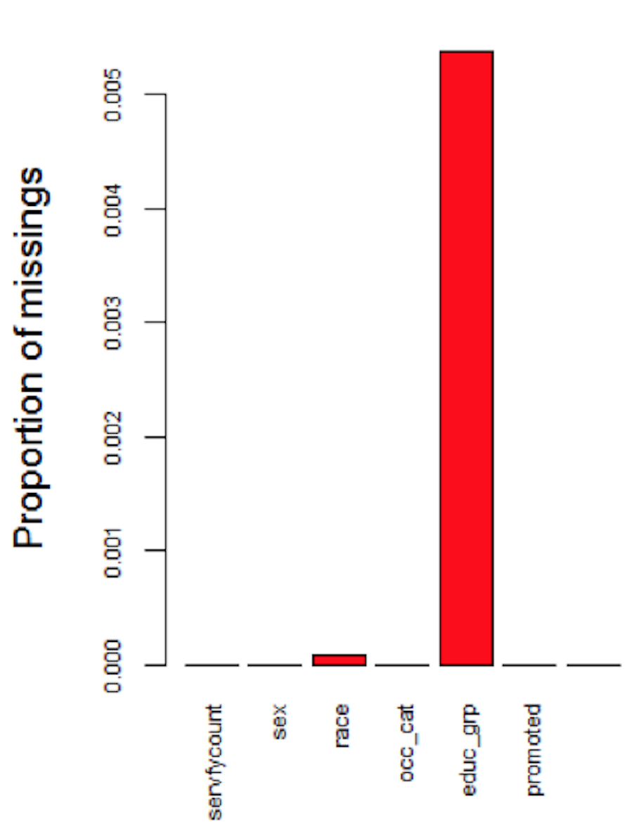
Inherent Missingness
Rules and Recording Standard Change
Race (< 0.1 %)
Education Level (< 0.5%)
Notes:
Race was originally classified into 16 categories, but new standard established in 2016 simplified it into 6 categories

Slide 9
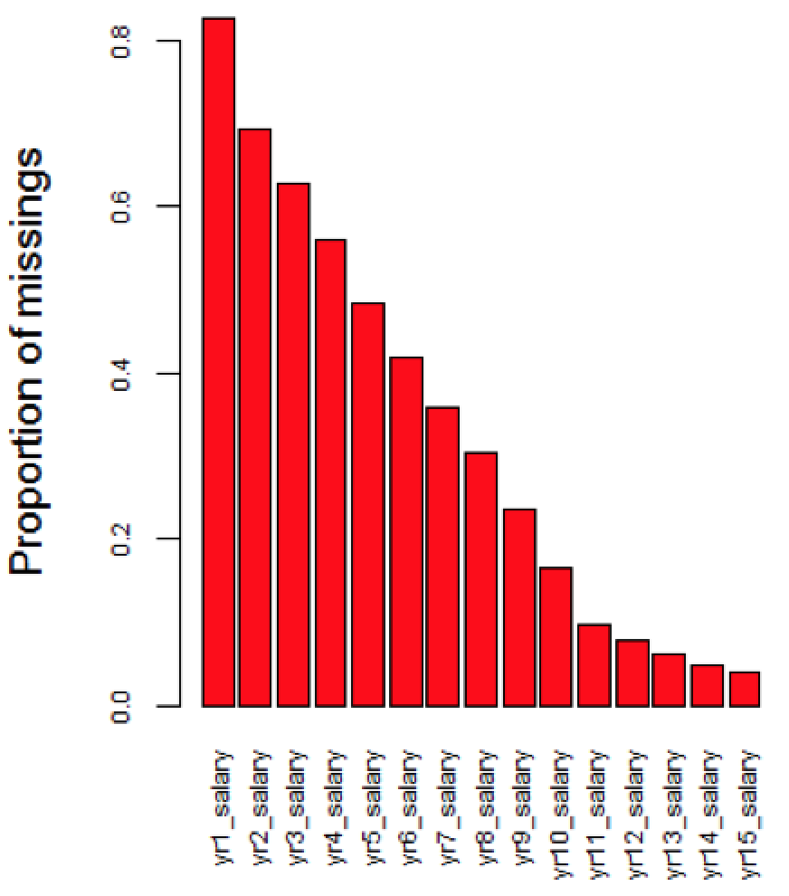
Missingness due to Time Constraint
OPM was not established until 1988
If employees started before 1988, part of their information will be missing
Pay Plan, Grade, Step Rate, Salary
Notes:
the proportion of missingness decreases as year increases

Slide 10
Assume Data has MAR property
Time constraint missingness
Assume relationships for variables before 1988 and after 1988 are dependent
Salary information before 1988 is dependent on observed education levels, pay plan, and grade after 1988
Inherent Missingness
Proportion of missingness is small

Slide 11
Addressing Missing Data – Multiple Imputation
Part 1: Fill in missing values to produce multiple completed datasets
Part 2: For each completed dataset, conduct analysis for parameters of interest
Part 3: Combine individual analysis to form final results
Notes:
The loss of information from missing data would produce bias and impact the robustness of statistical modeling and inference. To address this problem, it is necessary to impute the missing data.

Slide 12
Part 1: Fill in missing values to produce multiple completed datasets

Slide 13
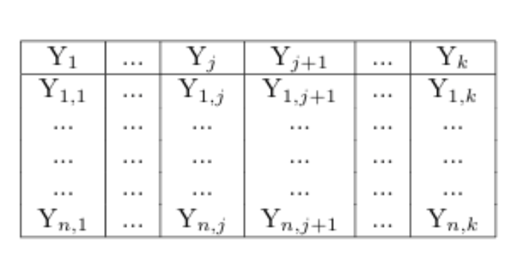
Multivariate Imputation by Chained Equation (MICE)
Notes:
MICE is one of the most popular approach for imputing missing data. It provides flexible imputation results and can handle both continuous and categorical data.

Slide 14
Step 1

Slide 15
Step 2
(a)
(b)

Slide 16
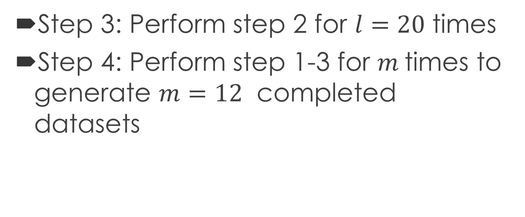
Step 3 & 4
Step 3: Perform step 2 for $l=20$ times
Step 4: Perform step 1-3 for $m$times to generate $m=12$ completed datasets

Slide 17
Conditional Distribution – Classification and Regression Tree (CART)
OPM data contains 65 variables and each categorical variable has multiple levels
GLMs might be difficult to capture variables with interactive and non-linear relationship
Non-parametric CART method is more appropriate
Notes:
one of the most common models for specifying predictive conditional distribution is Generalized Linear Models (GLMs). GLMs such as multiple linear regressions are flexible parametric models, and usually produce consistent imputation results. However, if the data to be imputed contain hundreds of variables, GLMs might be too simple to capture the true distribution.

Slide 18
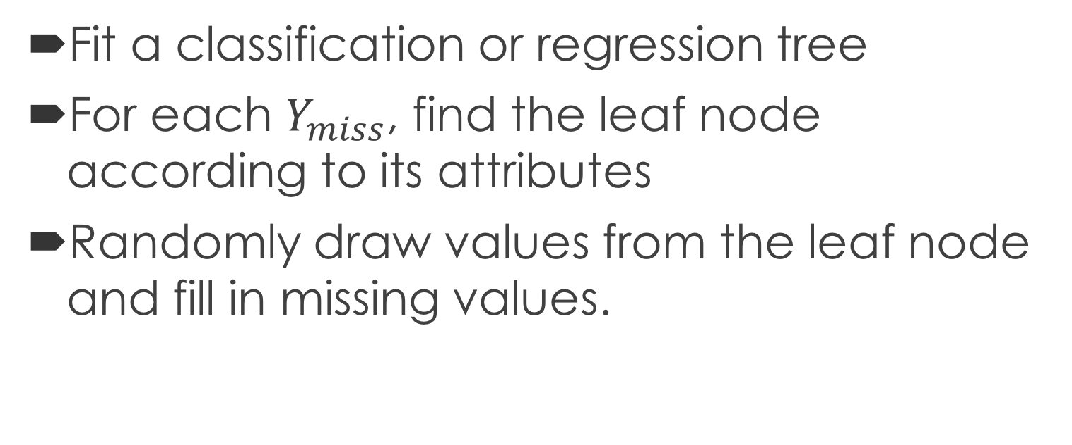
Classification and Regression Tree (CART)
Fit a classification or regression tree
For each $Y_{miss}$, find the leaf node according to its attributes
Randomly draw values from the leaf node and fill in missing values.

Slide 19
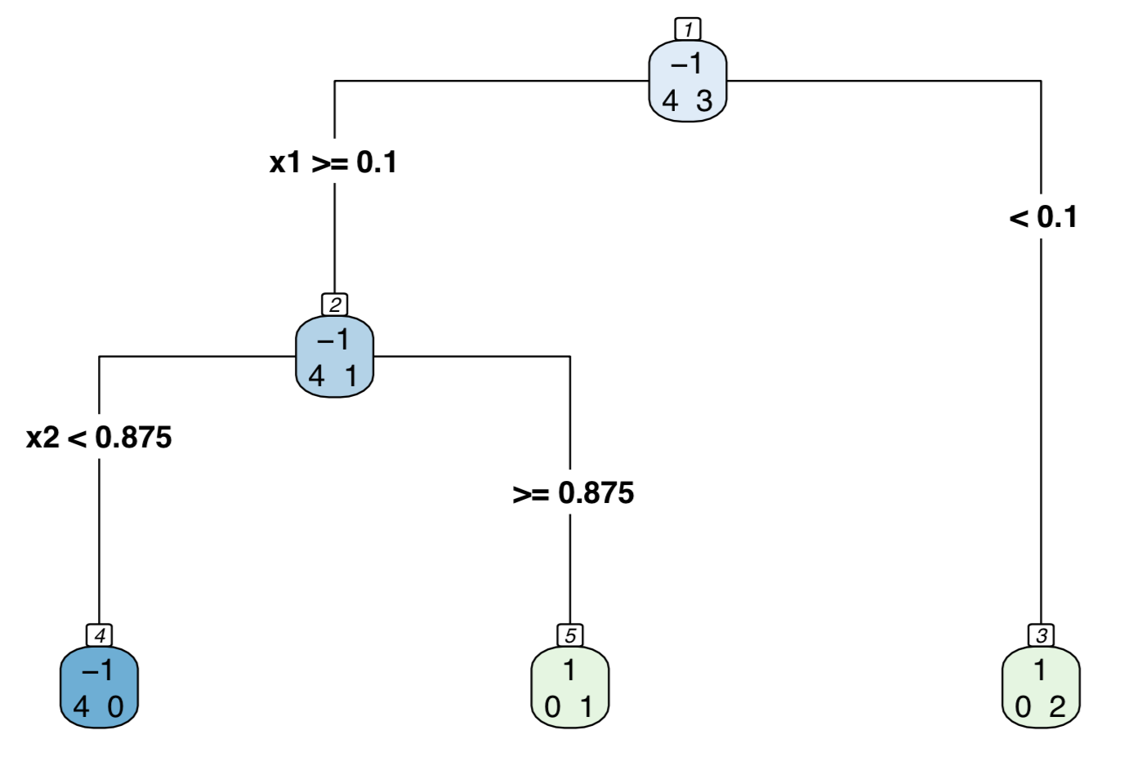
Classification and Regression Tree (CART)
Applied to Step 1 and Step 2

Slide 20
Classification and Regression Tree (CART)
Start at the top of the tree
Grow it by “splitting” attributes one by one. To determine which attribute to split, look at “node impurity.”
Assign leaf nodes the majority vote in the leaf
When we get to the bottom, prune the tree to prevent overfitting
Notes:
Grow the Tree ➔ Parameter ➔ Categorical (Index), Continuous (Index) Step 2: follow

Slide 21
Example of CART
Assume outcome variable is either 1 or -1
CART performs binary split based on reduction in Gini Index

Slide 22
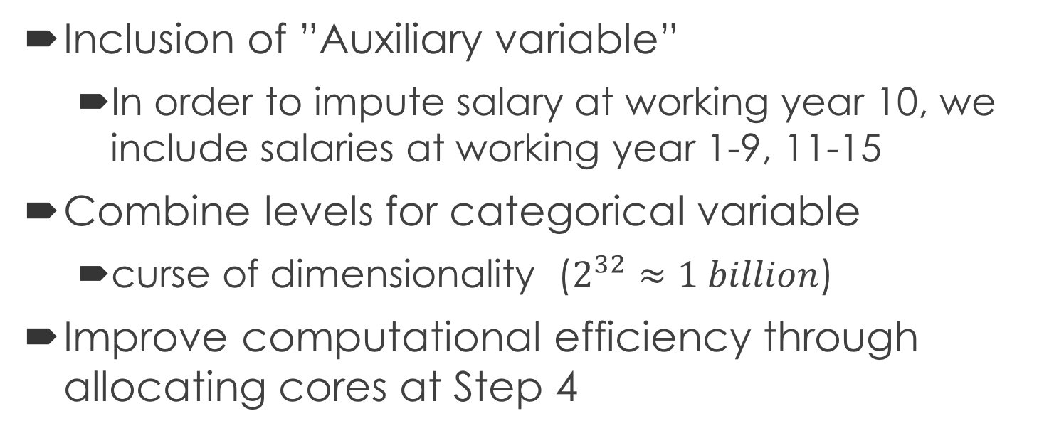
Strategies for Imputation
Inclusion of ”Auxiliary variable”
In order to impute salary at working year 10, we include salaries at working year 1-9, 11-15
Combine levels for categorical variable
curse of dimensionality ($2^{32}≈1 billion$)
Improve computational efficiency through allocating cores at Step 4
Notes:
Pay Plan is reduced from 173 categories into 7 categories.

Slide 23
Predictive Checks of Imputation Model
Model checking technique designed to investigate the potential model inadequacy between imputed and replicated datasets
Parameter of Interest: Relationship between salary at working year 1 and working year 10
Compare distribution between salary at year 1 and year 10 for imputed and replicated datasets

Slide 24
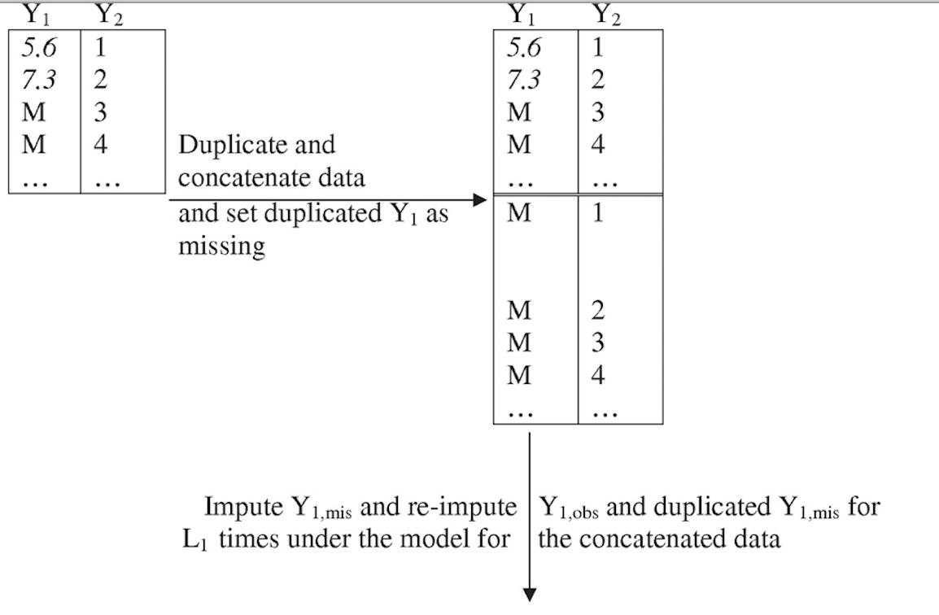

Slide 27
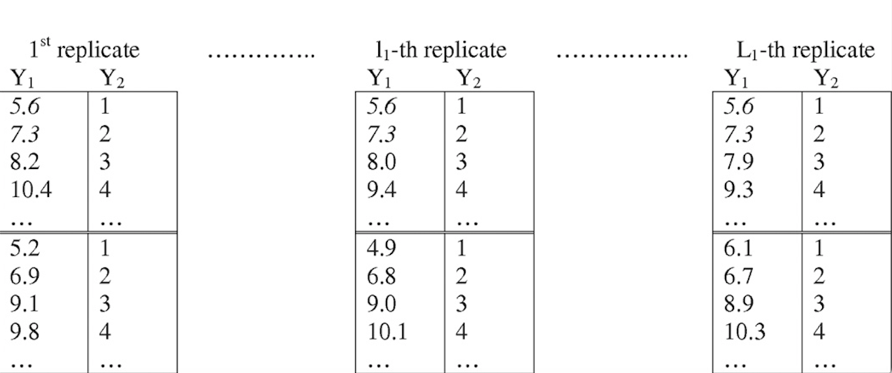
Re-impute concatenated dataset with original imputation model
Imputed
Replicated

Slide 28
Two Methods for re-imputation
Parameter of Interest: Relationship between salary at working year 1 and working year 10
Compare distribution between salary at year 1 and year 10 for imputed and replicated datasets

Slide 29
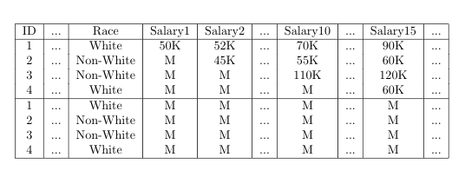
Method 1
Set all partially observed variable as completely missing

Slide 30
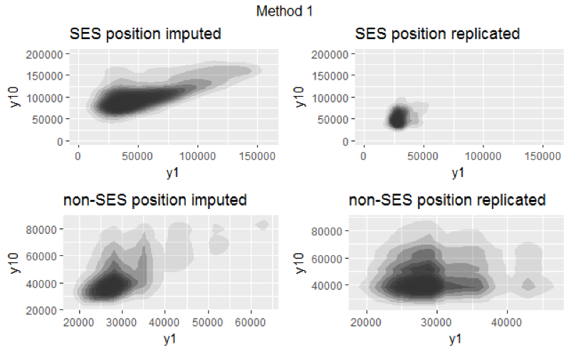
Method 1

Slide 31
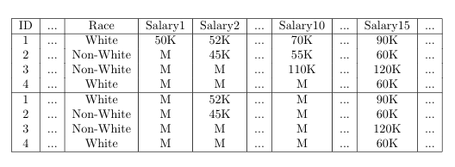
Method 2
Only set salary at year 1 and year 10 as completely missing

Slide 32
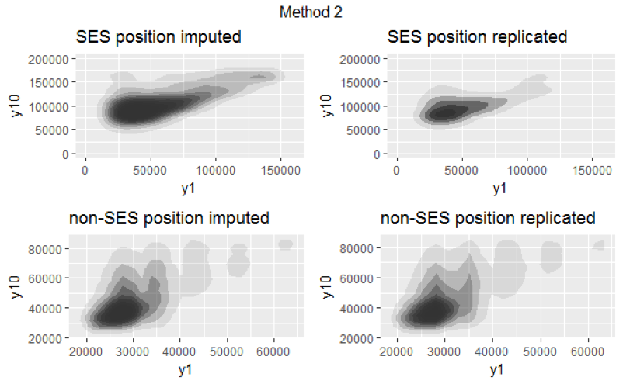
Method 2 – Only Set Year 1 and Year 10 Salary as Completely Missing

Slide 33
Part 2: For each completed dataset, conduct analysis for parameters of interest

Slide 34
Exploratory Data Analysis
For categorical predictors, we look at the percentages of ones in outcome variable for each level.
For continuous predictor, we first break predictor into n equally sized, ordered groups, and compute the percentage of ones in outcome variable for each group.

Slide 35
Covariates
Gender (M, F)
Race (White, Non-White)
Education Level (Less than Bachelor's, Bachelor's, Master's, Professional Degree & Advanced Certification, and PhD)
Department Switch (Switch, No-Switch)
Occupational Category (Administrative, Professional, and Other)
Supervisory Status (Supervisor, Non-Supervisor)
Yr10 Grade (Below 13, 13-14, 15)
Annual % change in salary (< 5 %, 5 – 10 %, > 10%)
Salary at working year 10

Slide 36
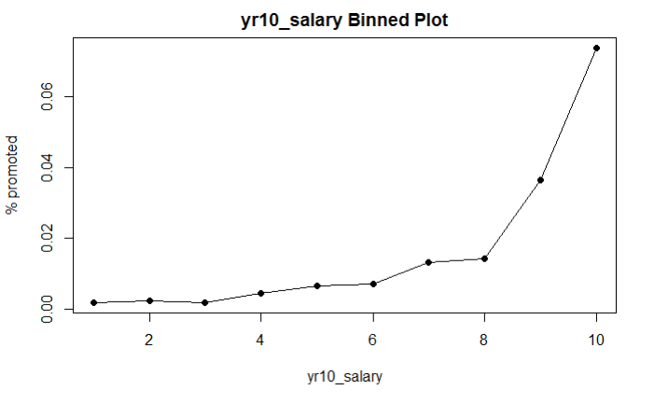
Continuous Variable – Year 10 Salary
For interpretation purpose, salary at working year 10 is rescaled
Binned plot shows the relationship between outcome variable and salary might be non-linear

Slide 37
Semi-parametric Spline Logistic Regression
A spline of degree D is a continuous function formed by connecting polynomial segments. The points where the segments connect are called the knots of the spline.

Slide 38
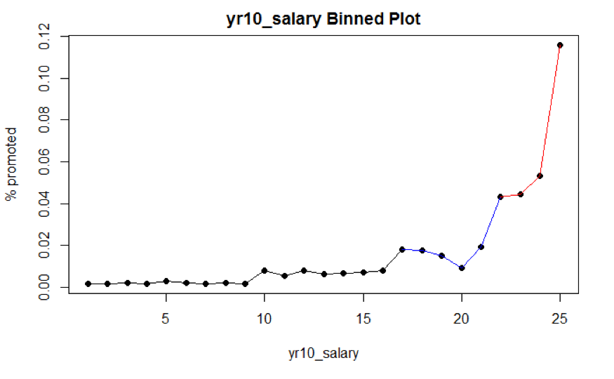

Slide 39
Piecewise Linear Regression
Notes:
For continuous predictor, we first break predictor into n equally sized, ordered groups, and compute the percentage of ones in outcome variable for each group.

Slide 40
Selecting Knots for Spline Logistic Regression
Knots are selected manually ($71,674 & $84,697)
Given the rarity of the promoted employees (482 out of 27,932), degree = 1 to avoid overfitting.

Slide 41
Final Model
Change in deviance test (p-value = 0.846) suggests variable Race, Gender, and Department Switch are not important predictors.

Slide 42
Coefficient Estimation
Approach 1: Maximum Likelihood Estimation
Approach 2: Bayesian Posterior Distribution
Prior Intercept: Normal(0,5)
Prior Coefficient: Normal(0,5)

Slide 43
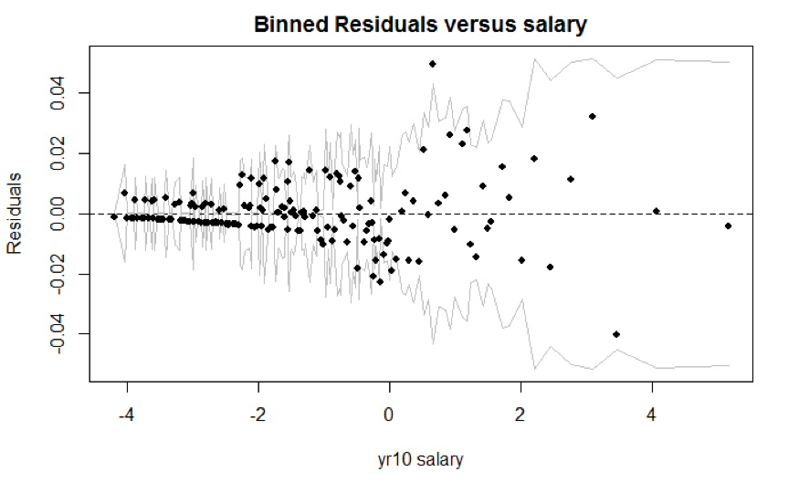
Model Checking

Slide 44
Part 3: Combine individual analysis to form final results

Slide 45
Combined Model Coefficients
MLE: Adopt Rubin’s approach to average out coefficients mean and account for within and across datasets SE
Bayesian: Combine posterior draws for each dataset to retrieve statistics of interests

Slide 46
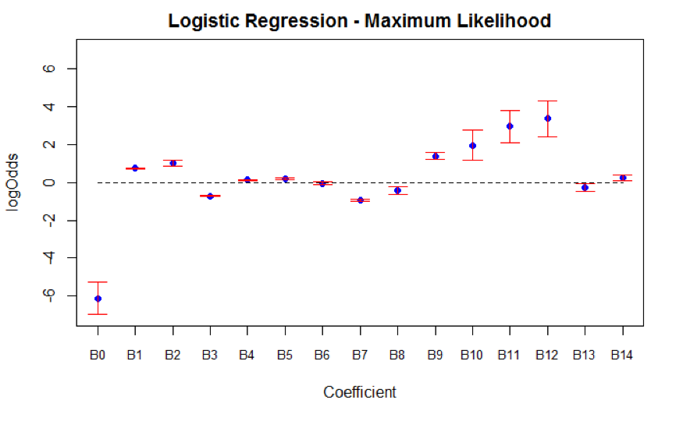
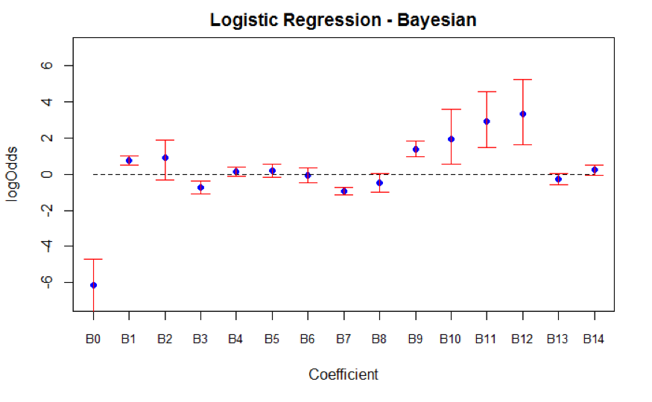
MLE vs. Bayesian
Notes:
Bayesian has higher variability for coefficients estimation ➔ might due to the fact that we do not have enough datasets, which is the requirements for Bayesian pooled analysis.

Slide 47
Inference
Personal Skills
Occupational Category
Supervisory Status
Education Levels
Below Bachelor’s vs. Bachelor’s
PhD
Performance at Work
Notes:
the odds of getting promoted are multiplied by a factor of 0.387 (95% CI: 0.365 to 0.411) than employees who serve in supervisory positions
the odds of getting promoted is multiplied by 0.490 (95% CI: 0.473 to 0.508) compared to employees with Bachelor’s degree
compared to employees with only Bachelor’s degrees, the odds of getting promoted increases if employees acquired Master’s and Advanced degrees but decreases if employees acquired PhD degrees

Slide 48
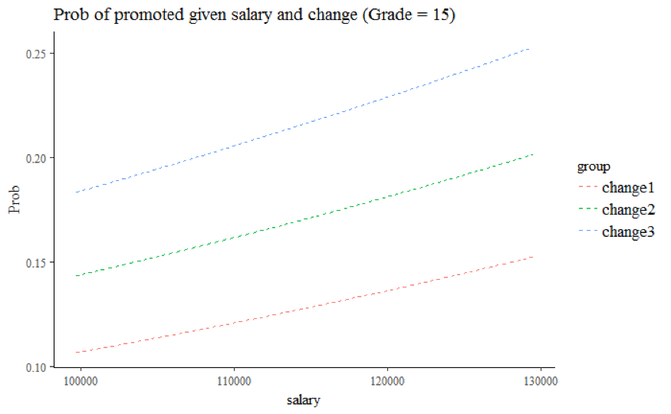
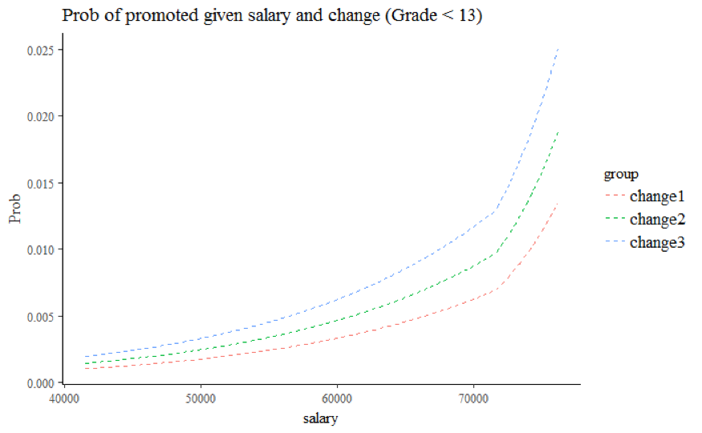
Inference

Slide 49
Conclusion
Predicted model is highly sensitive to imputation results
It would be interesting to see model’s prediction results for the full dataset

Slide 50
Thank you!
Notes:
cp: complexity parameter. Any split that does not decrease the overall lack of fit by a factor of ‘cp’ is not attempted.
(cp = 0.01)

